Slide 1
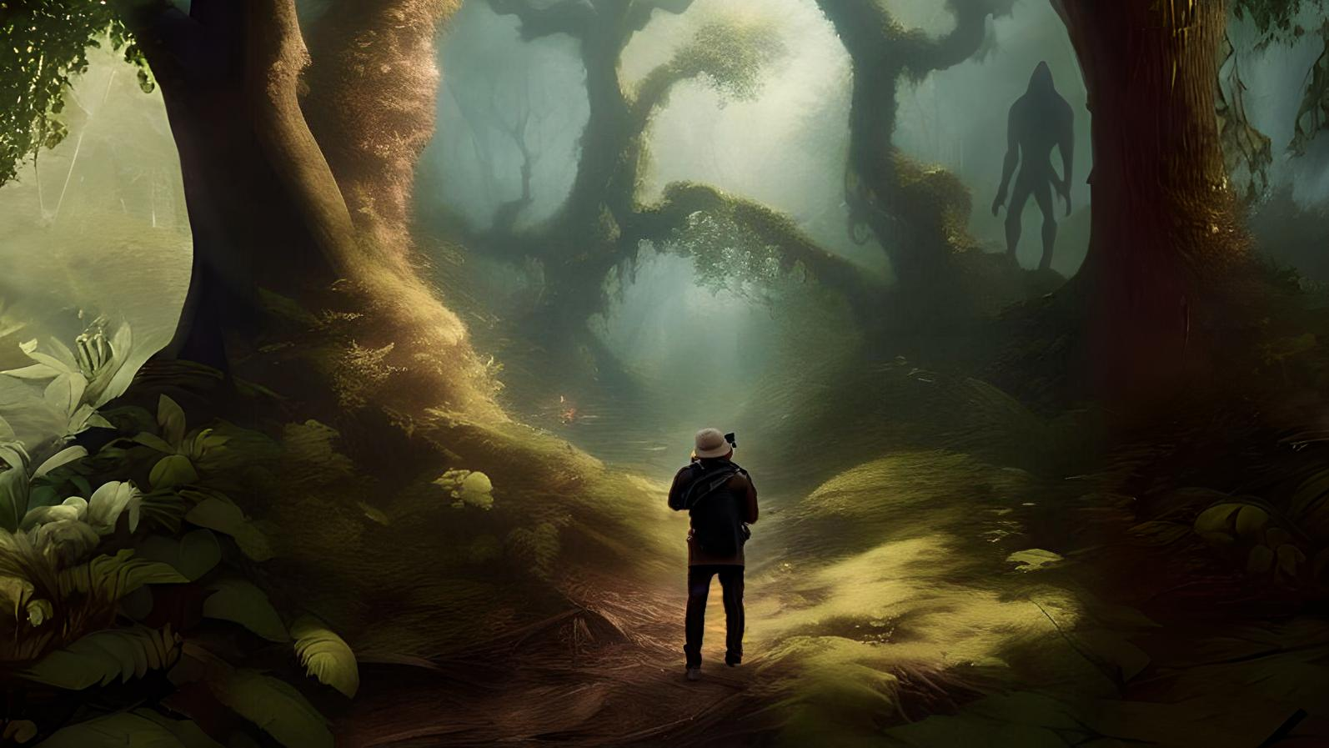



Greta
Sorritelli

Slide 2
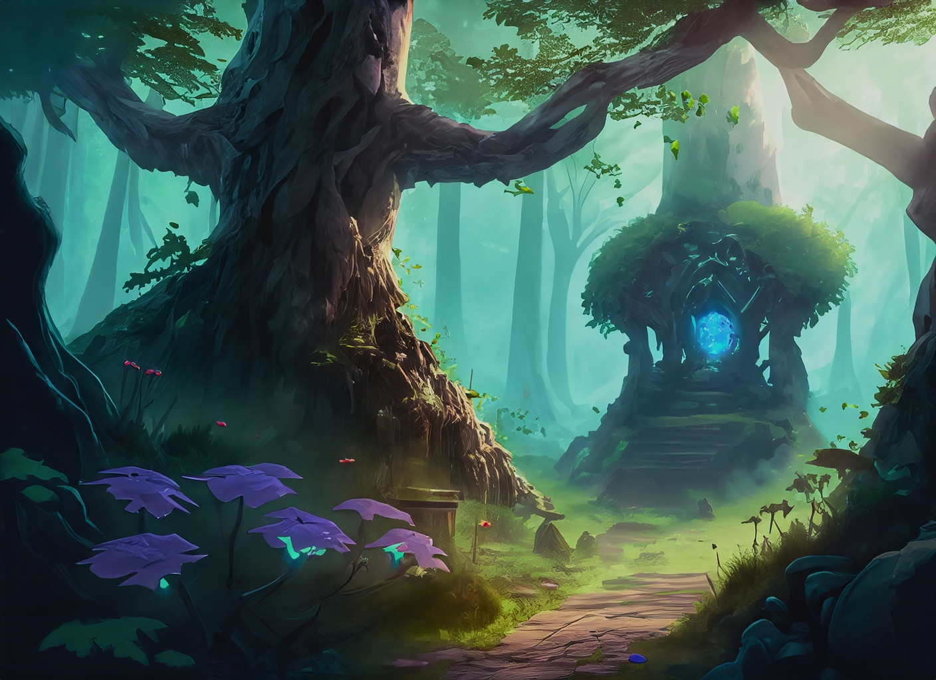
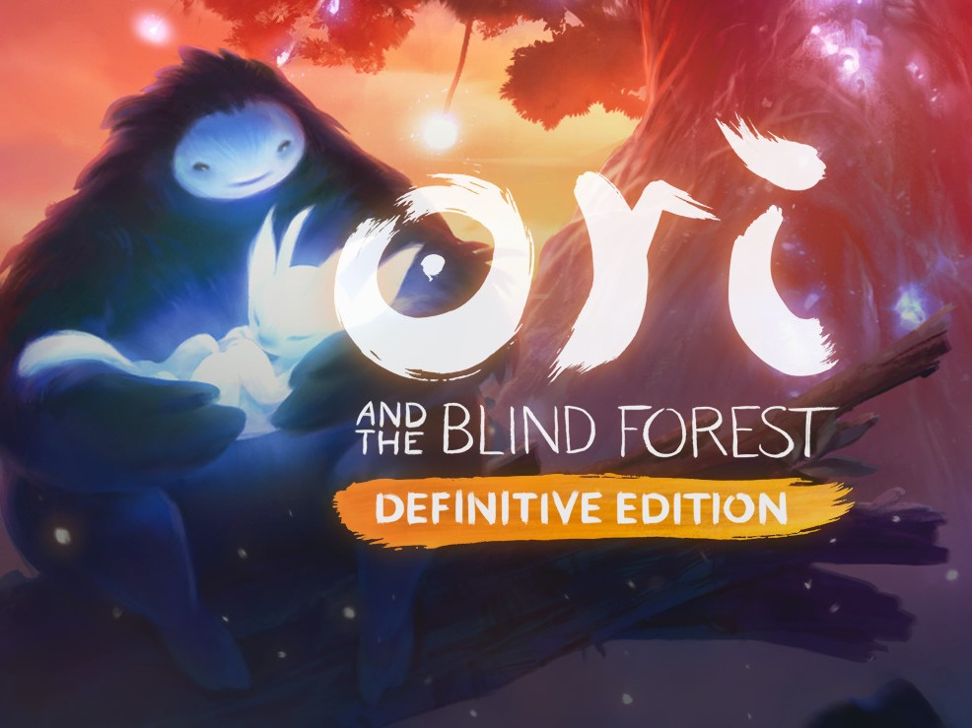
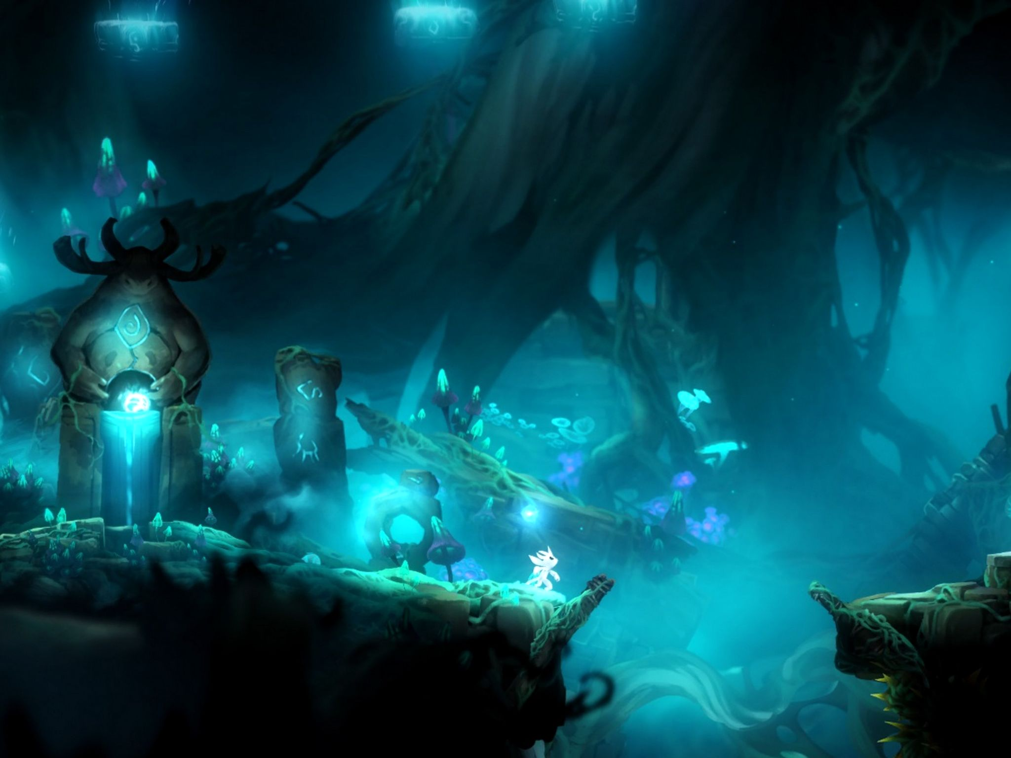
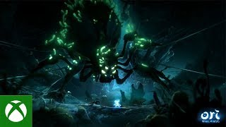
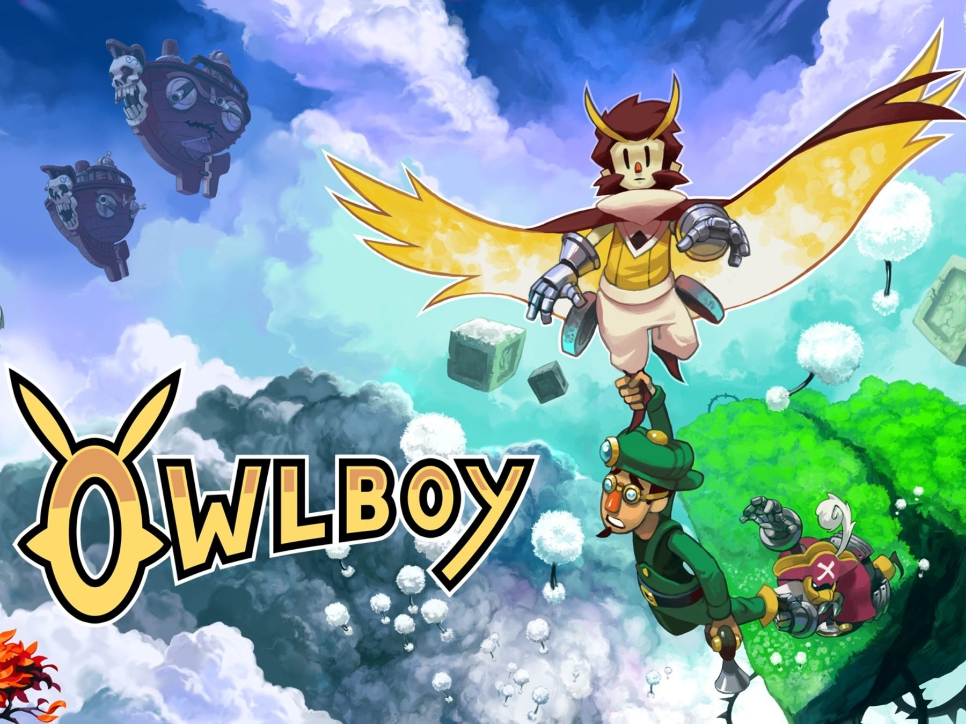
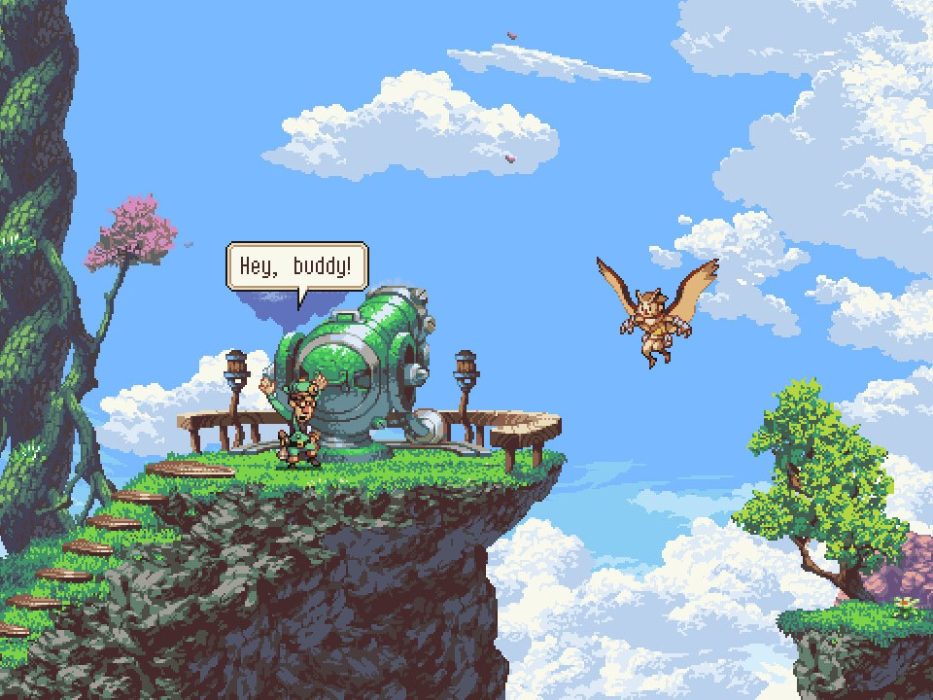
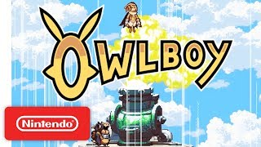
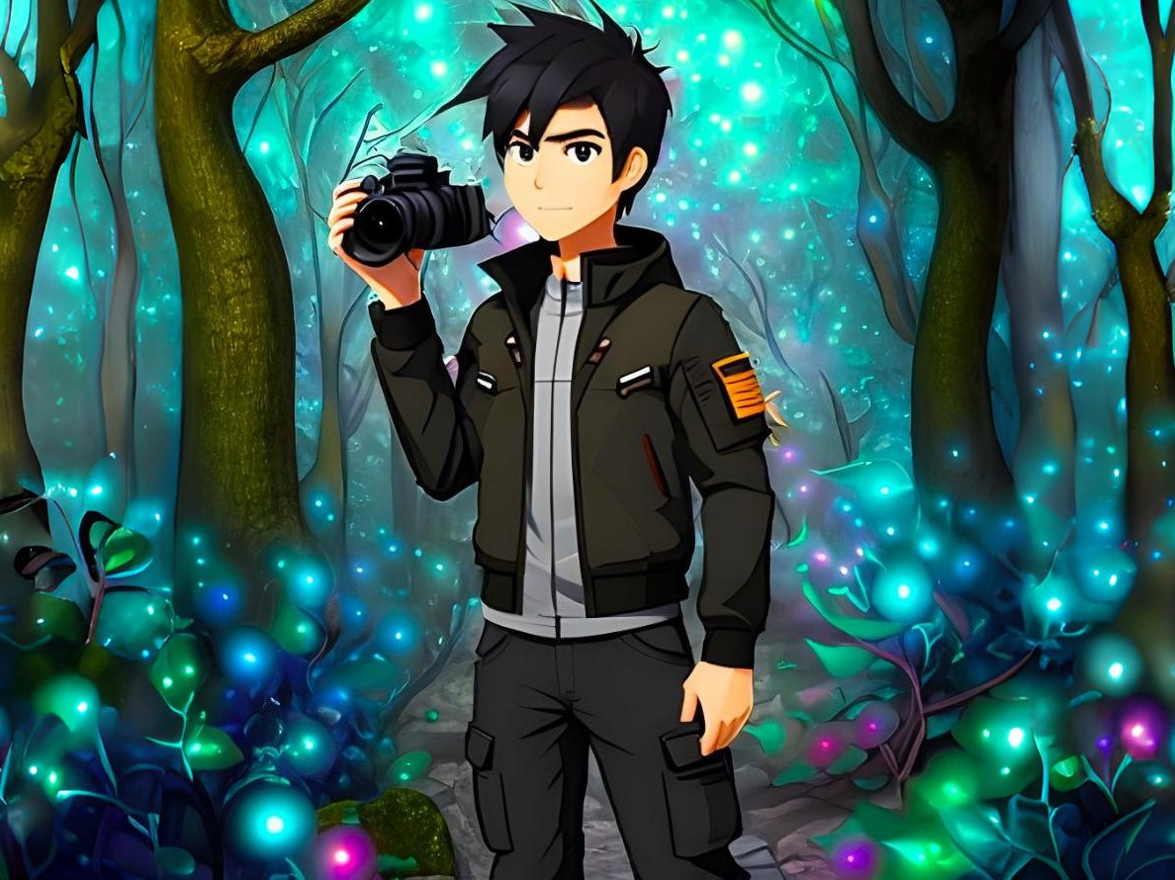
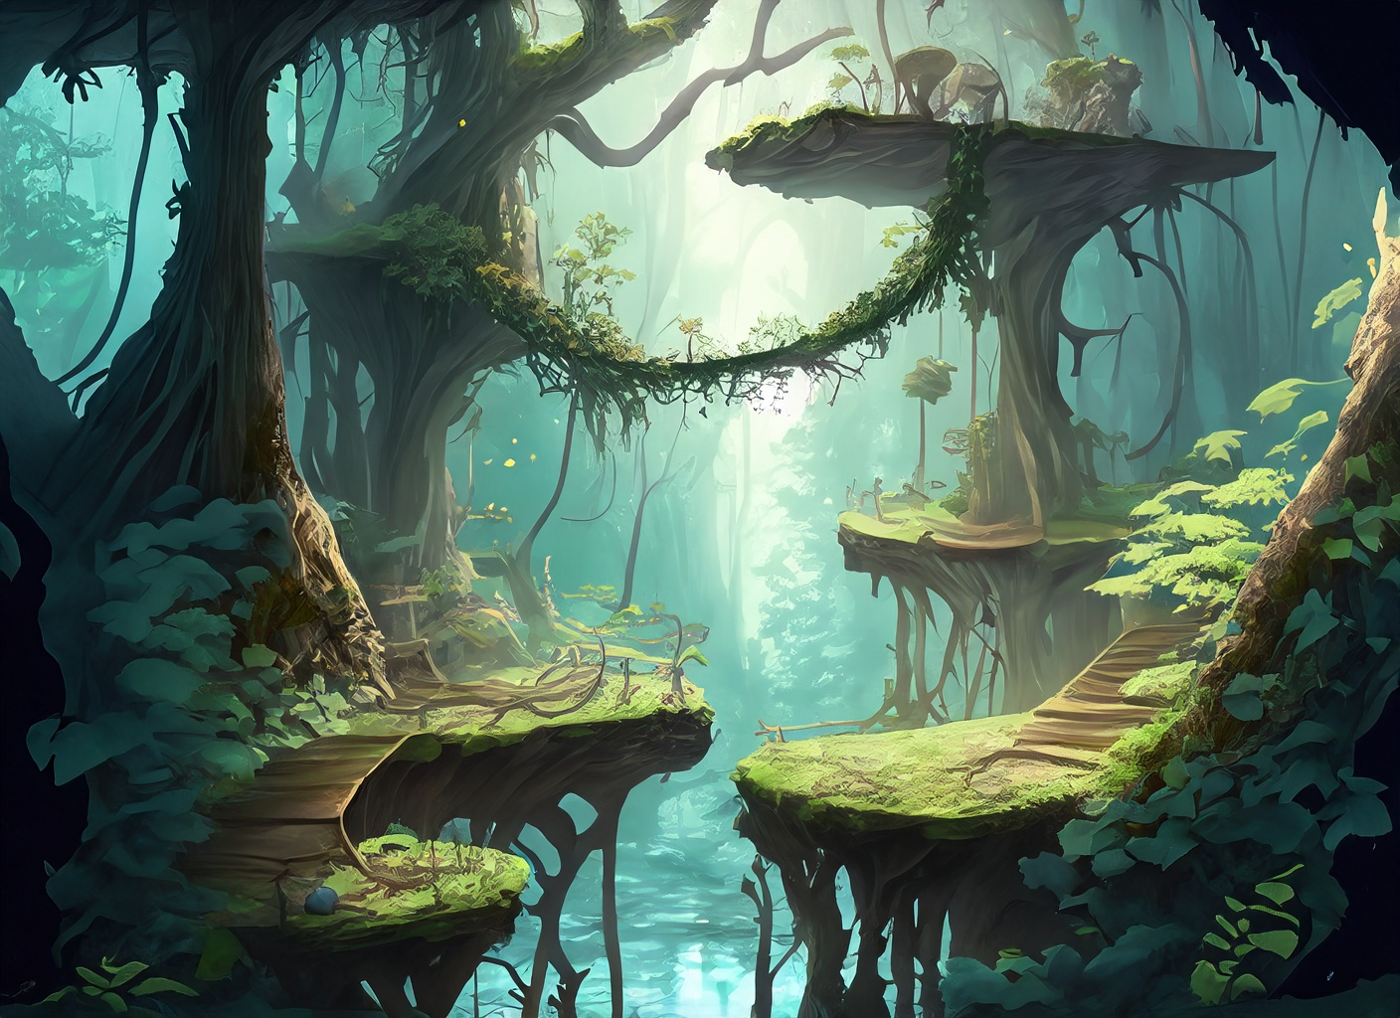
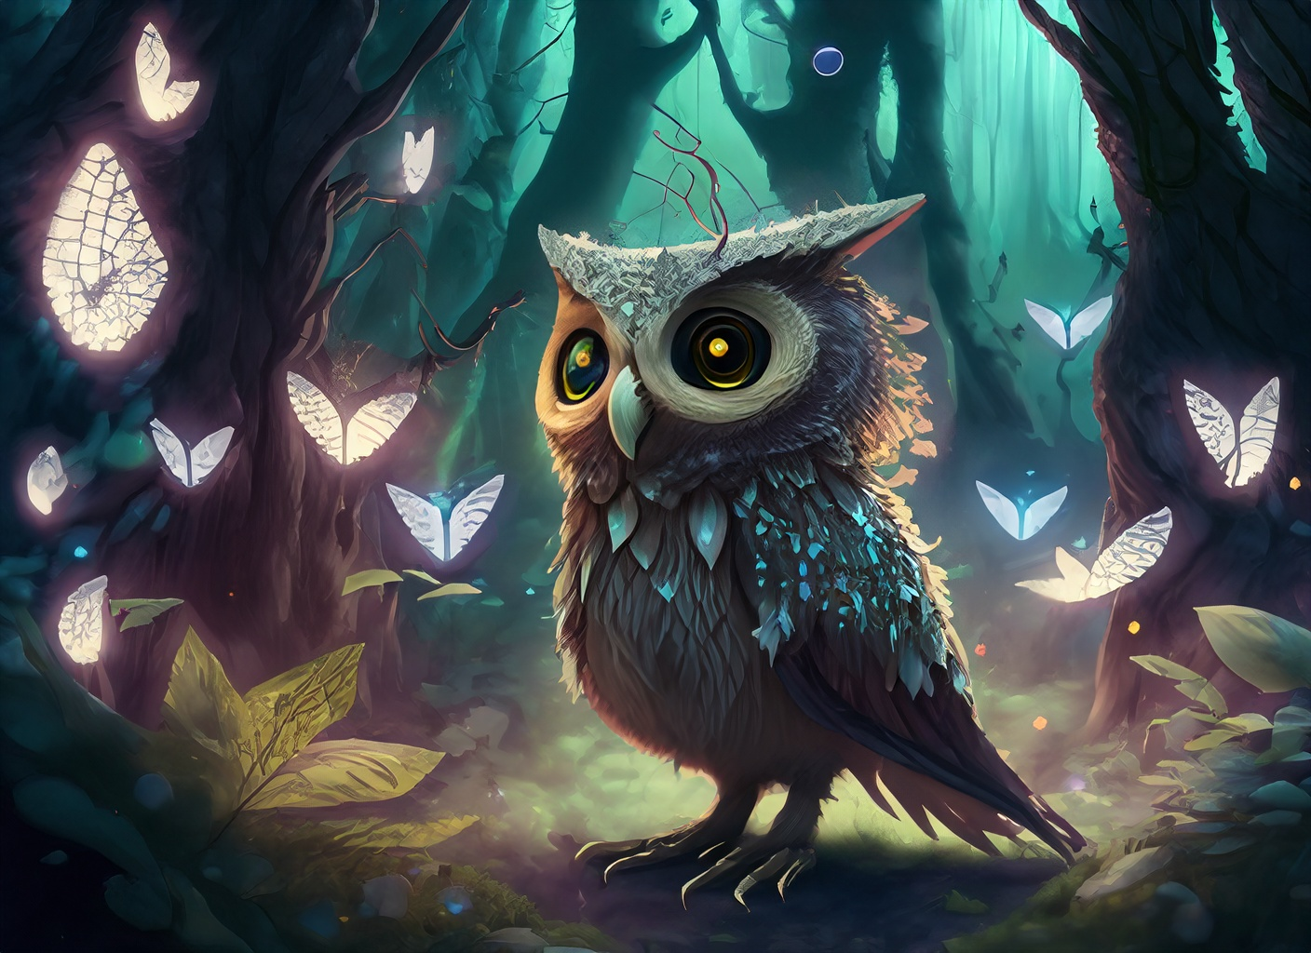
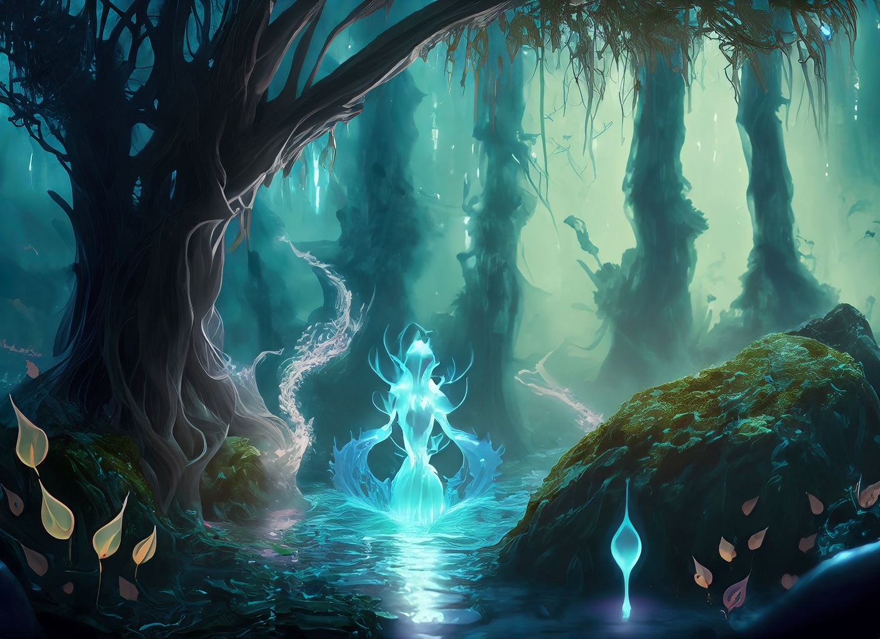
+
=

Slide 3
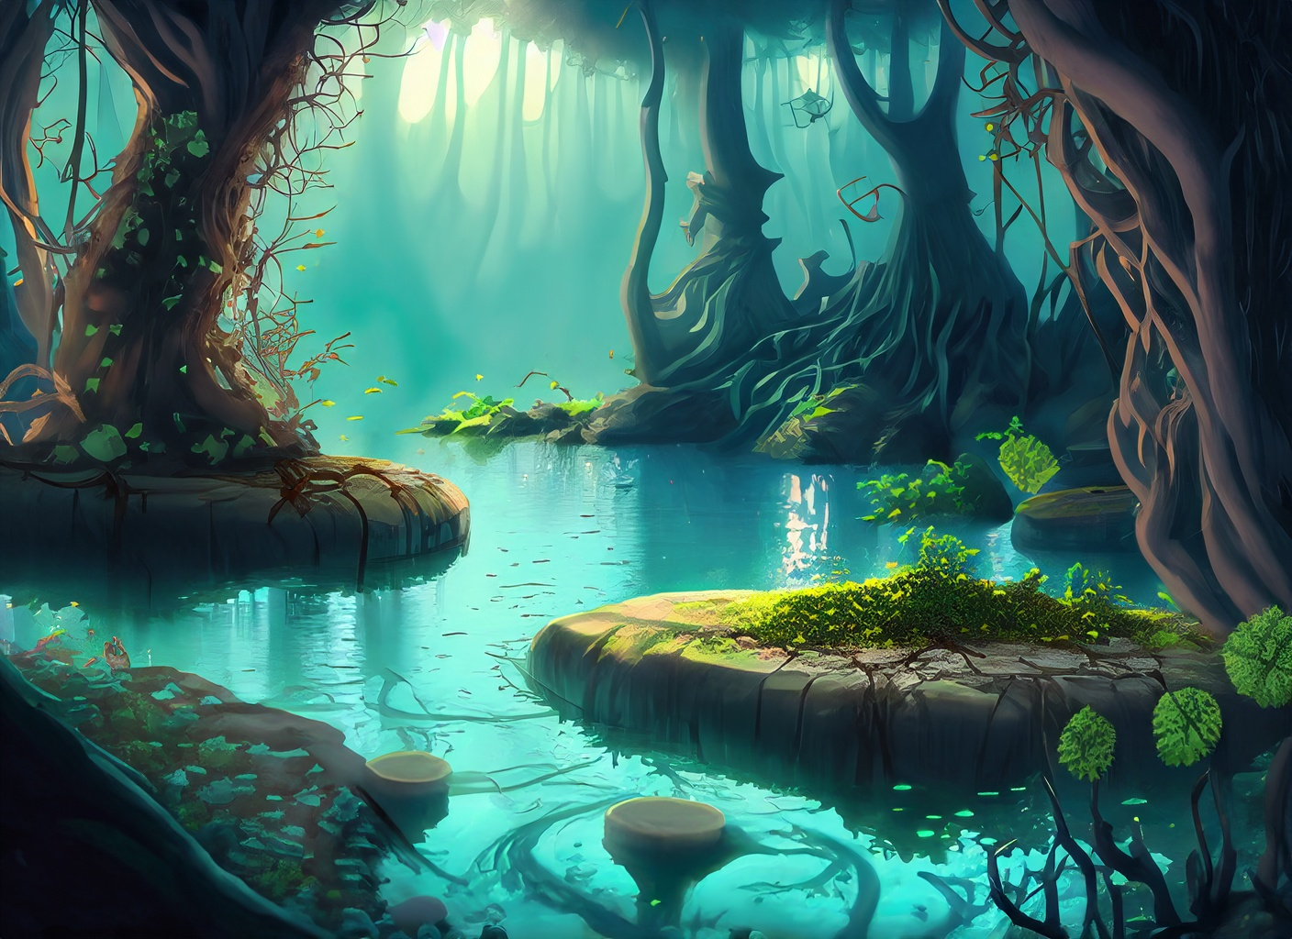
Title | Mystery’s Lens
Slogan | “Master the Lens, Unearth the Unseen”
Genre | 2D Platformer, Adventure, Fantasy, Serious Game
Theme | Photography, Supernatural, Enchantment
Style | 2D, Fantasy-themed with magical visuals

Slide 4
Platform | PC (Windows, macOS, Linux)
Target | Adventure game enthusiasts, Photography enthusiasts, Casual gamers. ESRB E10+
Localization | Potential for multi-language support
Longevity | Replayability through diverse levels, post-launch updates, potential for expanding content.

Slide 5
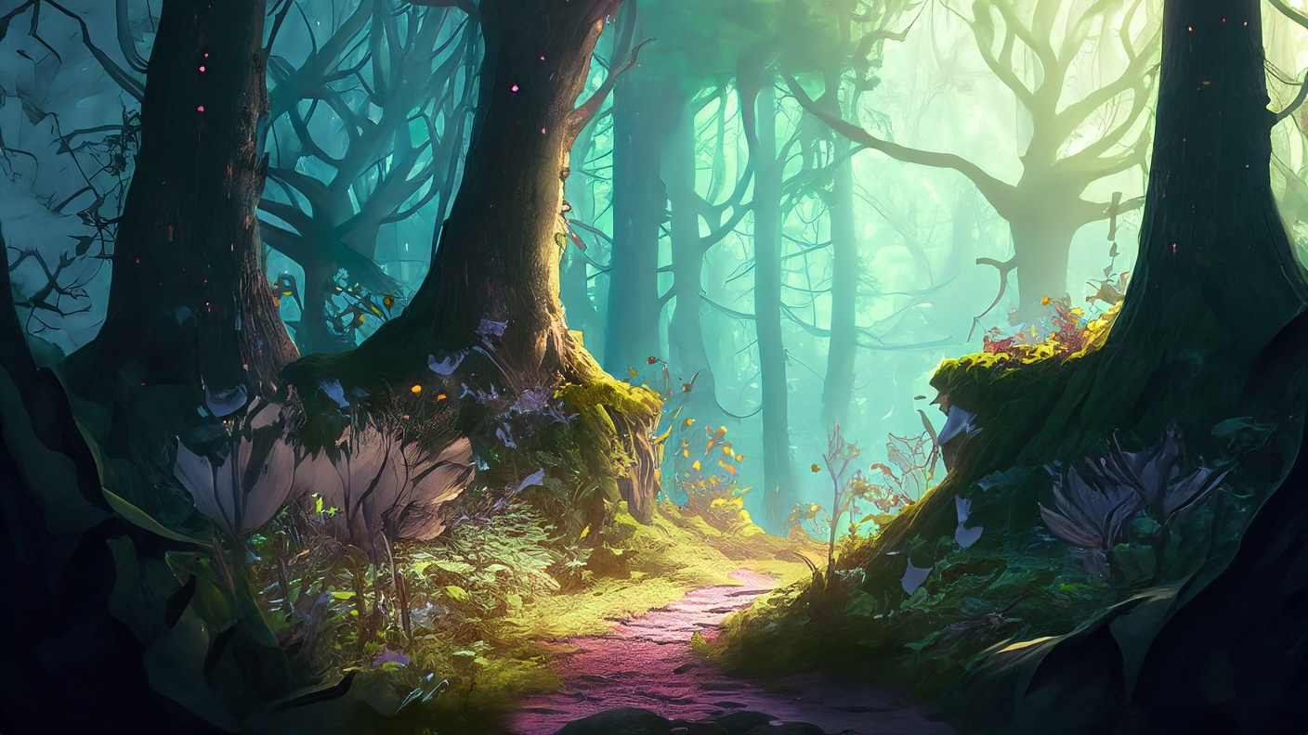
Unique Selling Proposition (USP):
Blend of photography mechanics and fantasy platforming
and photography quizzes
Monetization & Remuneration:
Premium game model with in-game virtual currency,
DLC packs,
potential for merchandise and licensing opportunities

Slide 6
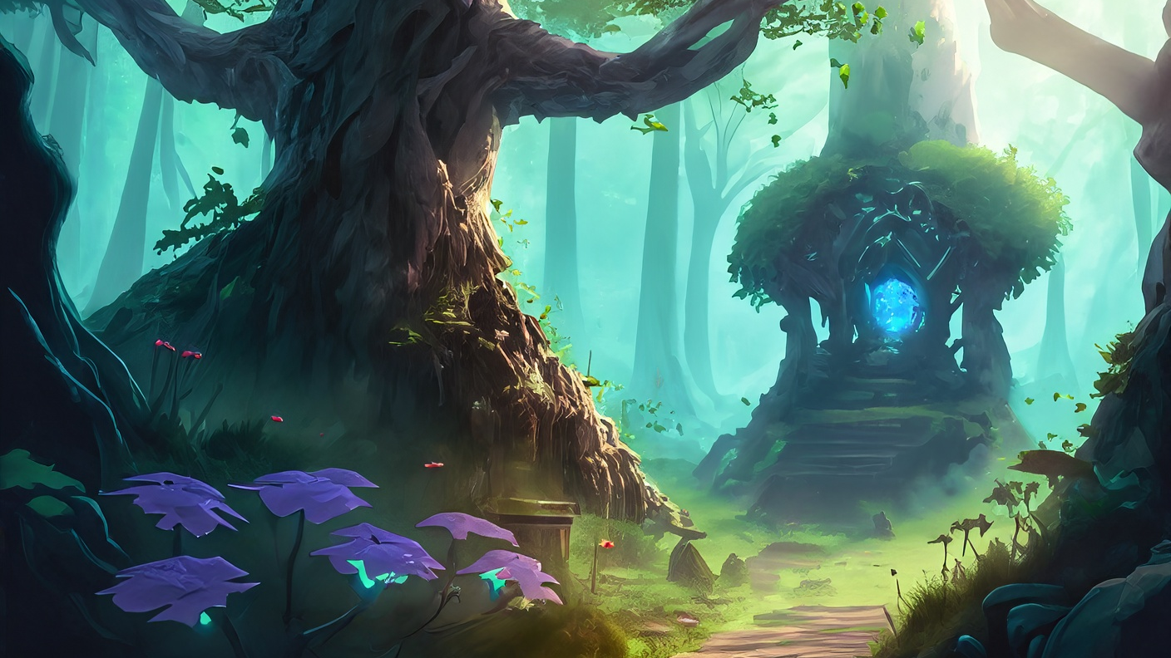
Concept
Description
Mystery’s Lens is a 2D platformer for PC.
As players progress through the enchanting forest, they will encounter unique
challenges in each level.
They must also demonstrate their knowledge of photography through themed quizzes. By correctly answering questions related to photography, players can finish the levels or unlock rewards.
Story
The protagonist is a skilled and brave photographer exploring a fantasy forest filled with supernatural beings on a quest to uncover the truth behind a
legendary monster. To reach the monster’s lair at the heart of the forest, the protagonist must overcome various obstacles.

Slide 7
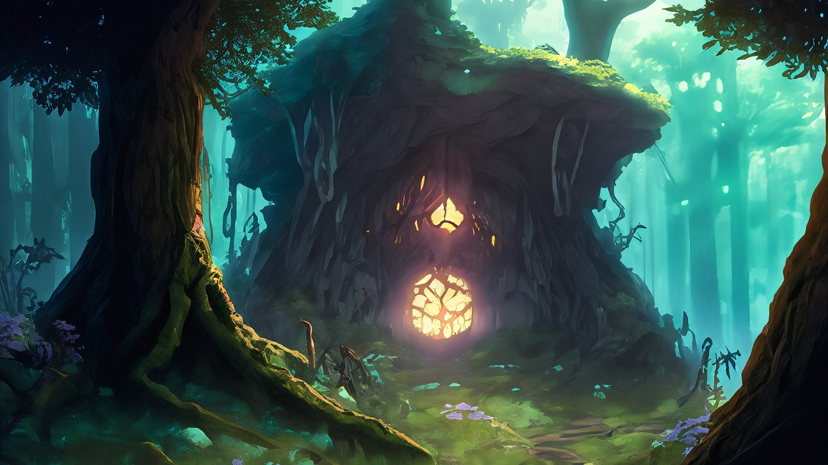
Gameplay
It combines elements of platforming, puzzle-solving,
and photography mechanics to create an engaging and immersive experience.
Core objective: to reach the center of the forest and find the lair of the legendary monster.
Along the way, players encounter various obstacles, such as hostile animals, mischievous creatures, and treacherous streams or poisonous plants.
As a photographer, the protagonist possesses a magical camera with special abilities.
Players must strategically utilize these camera abilities to overcome obstacles, unlock secret areas, and progress through the game.

Slide 8
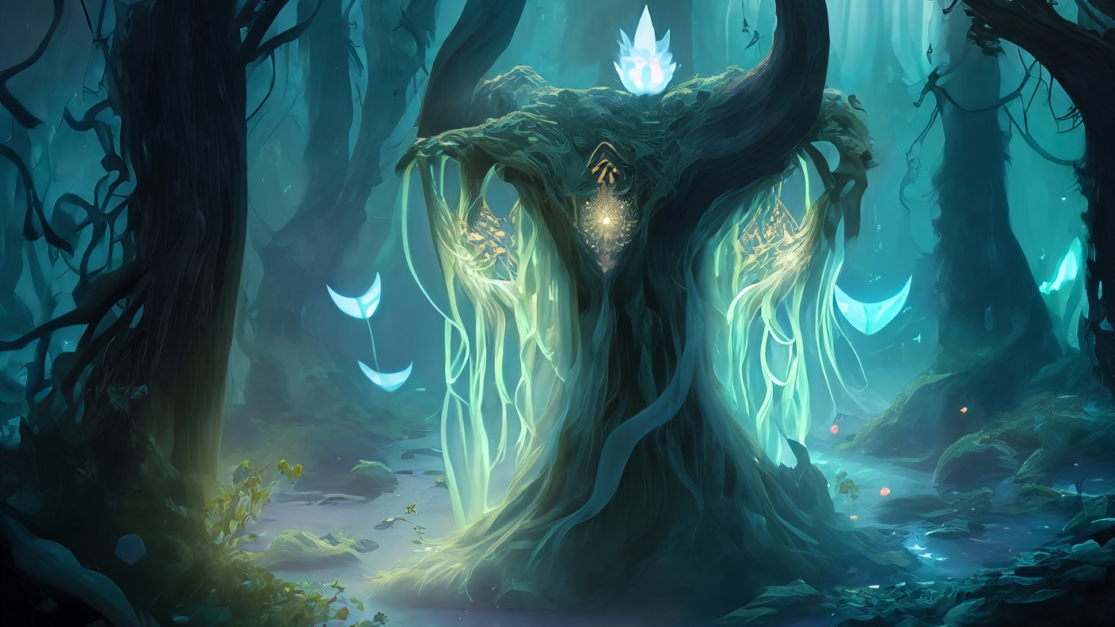
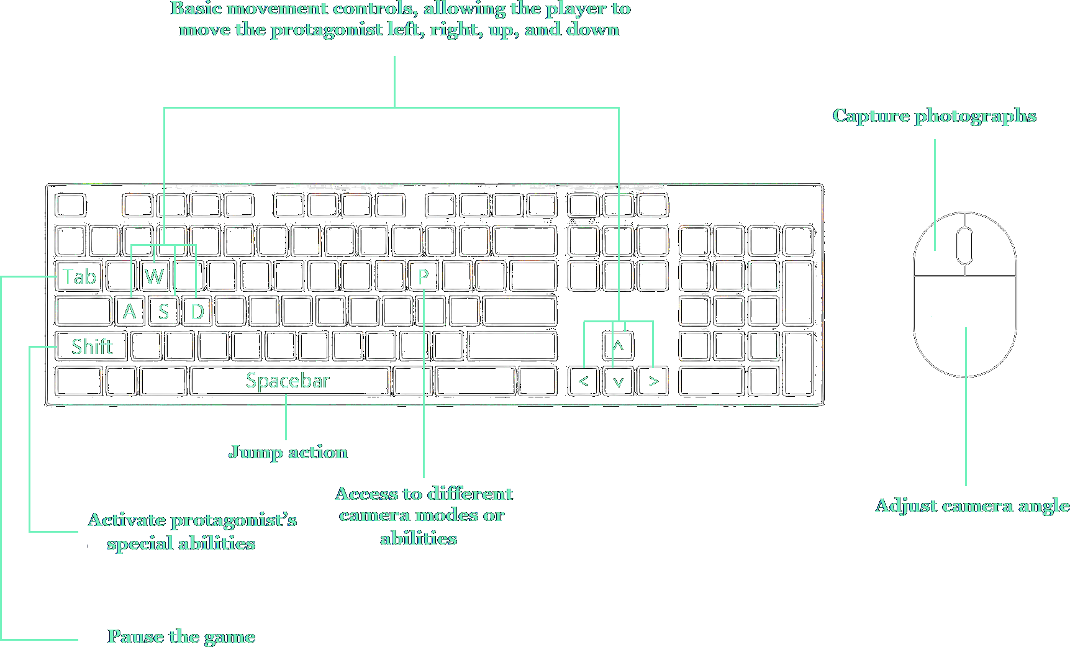
Controls

Slide 9
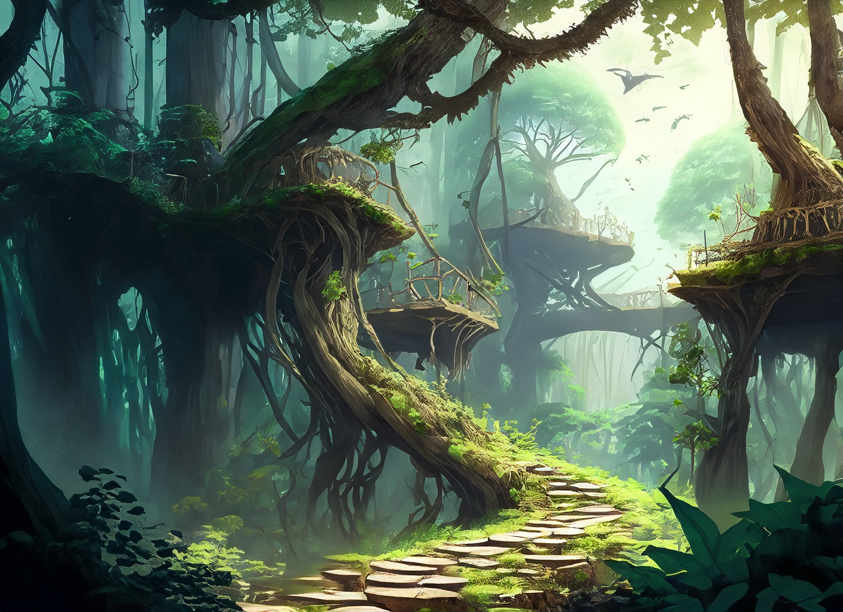
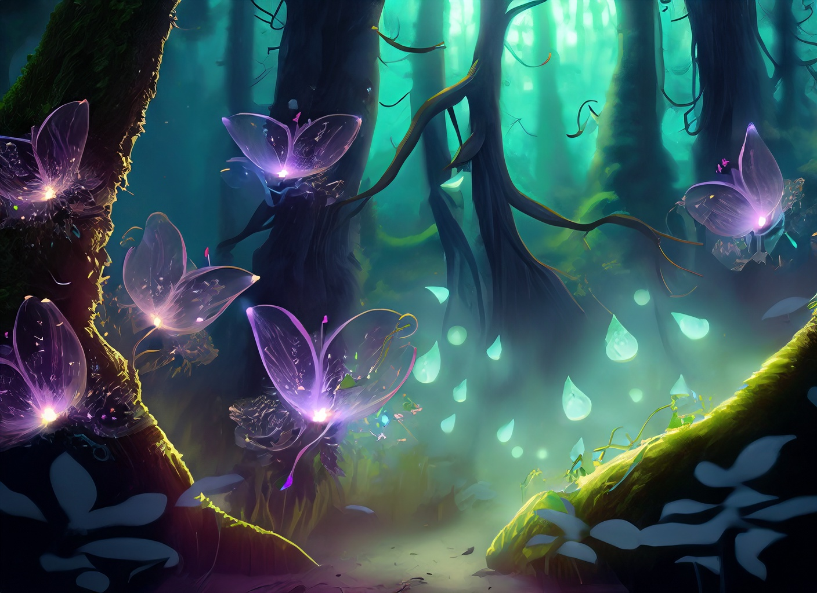
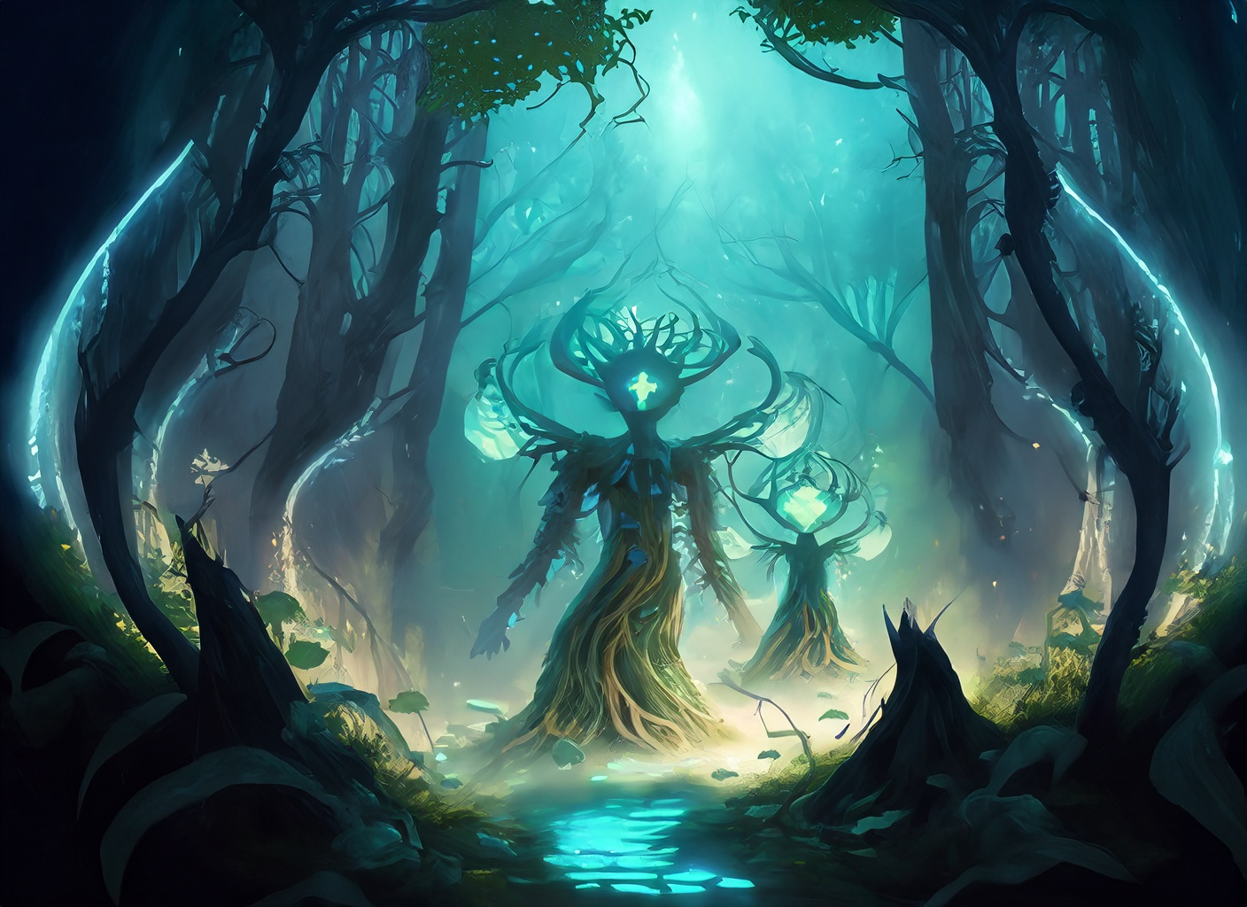
Spritelights
Lumina
Art: Characters
The Photographer
Water Guardian Spirits
Forest Guardian Spirits

Slide 10
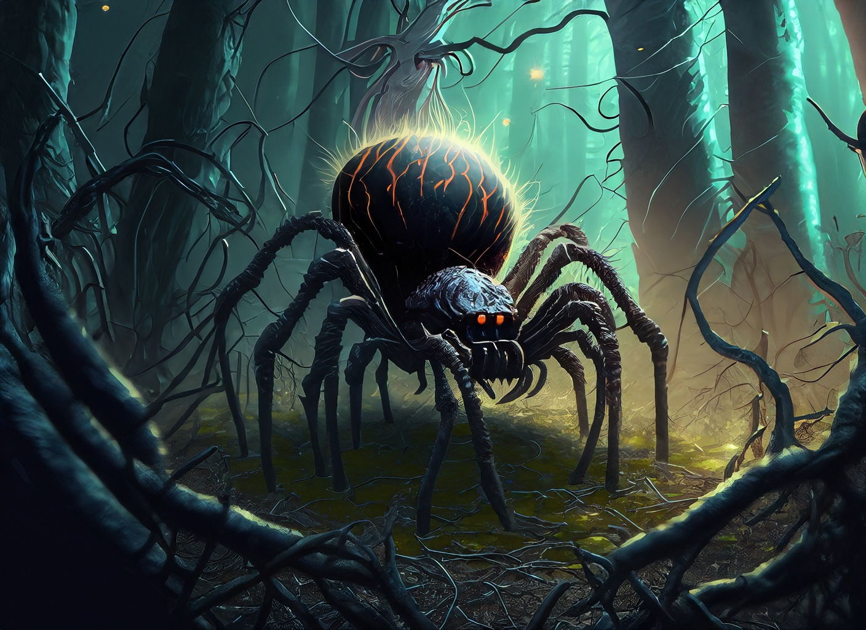
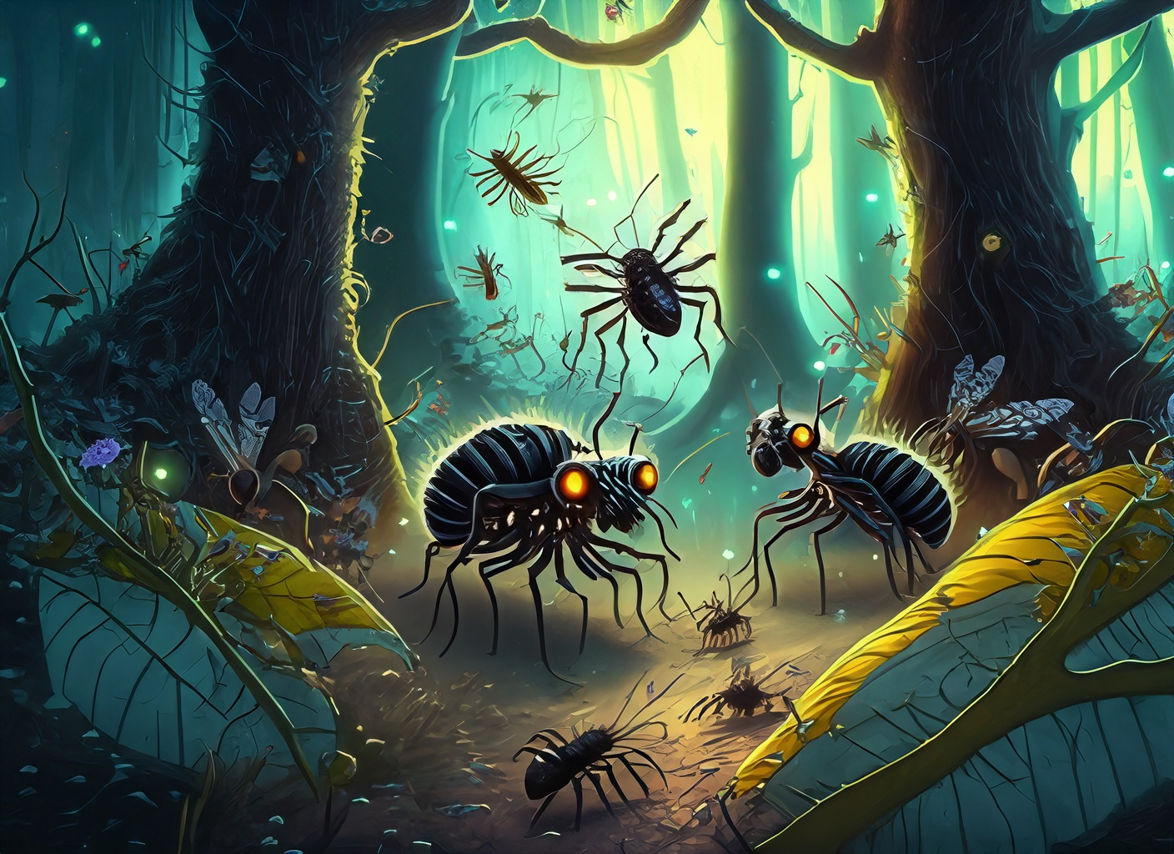
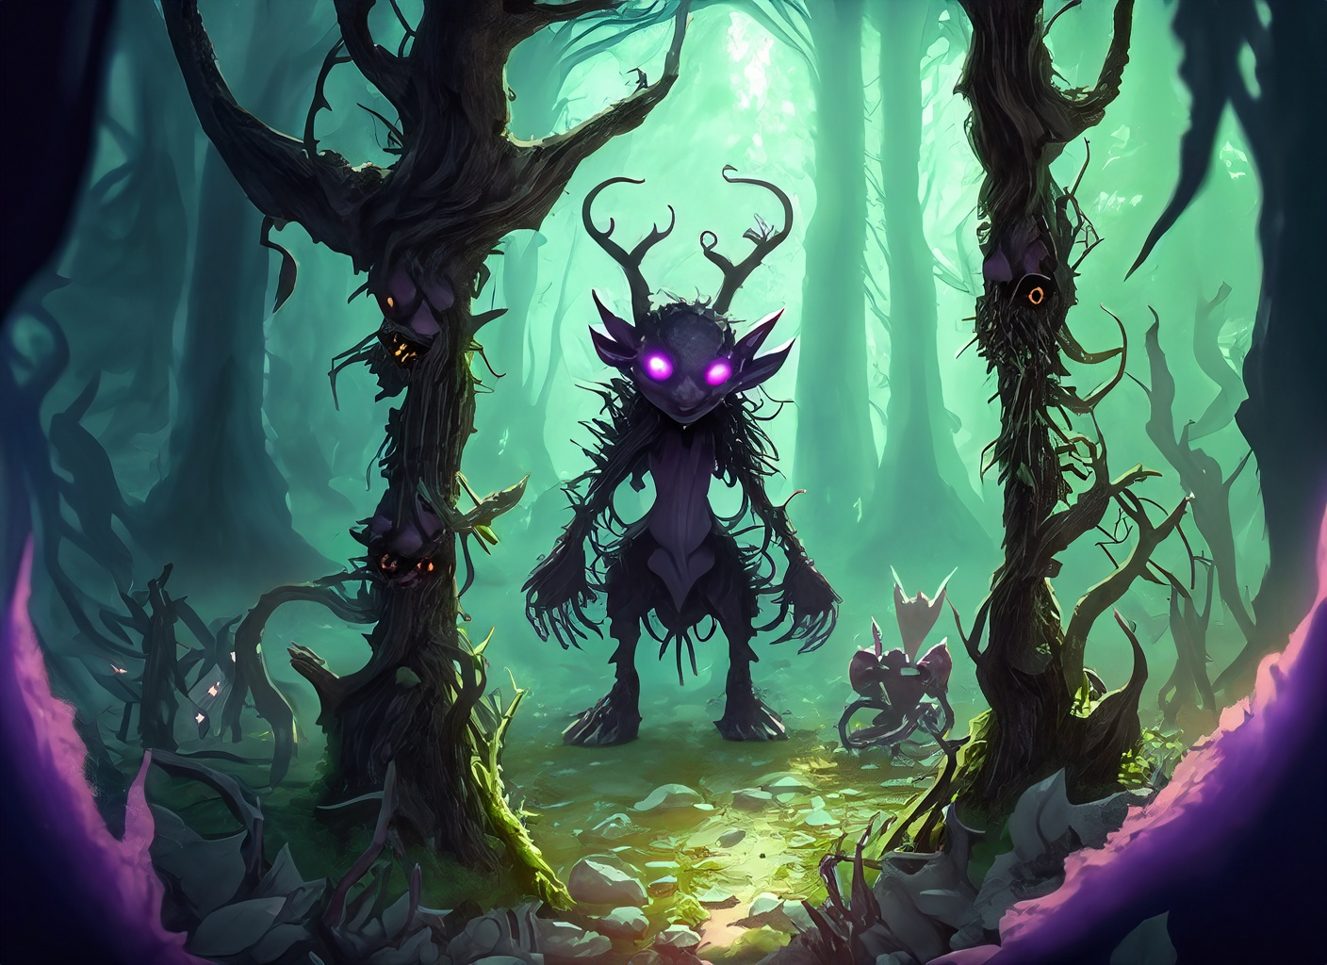
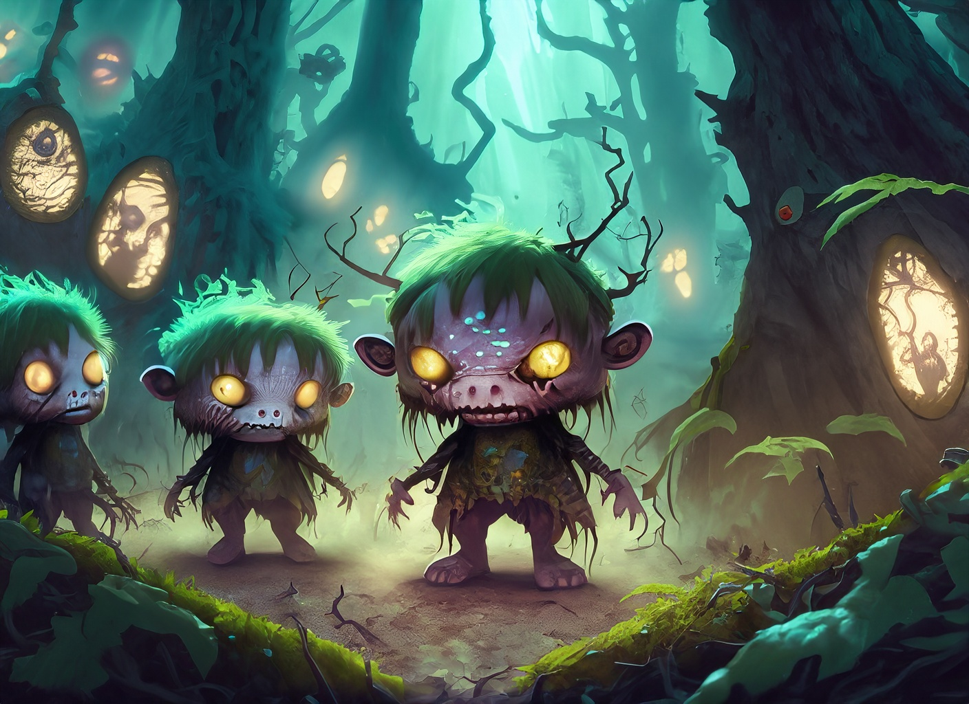
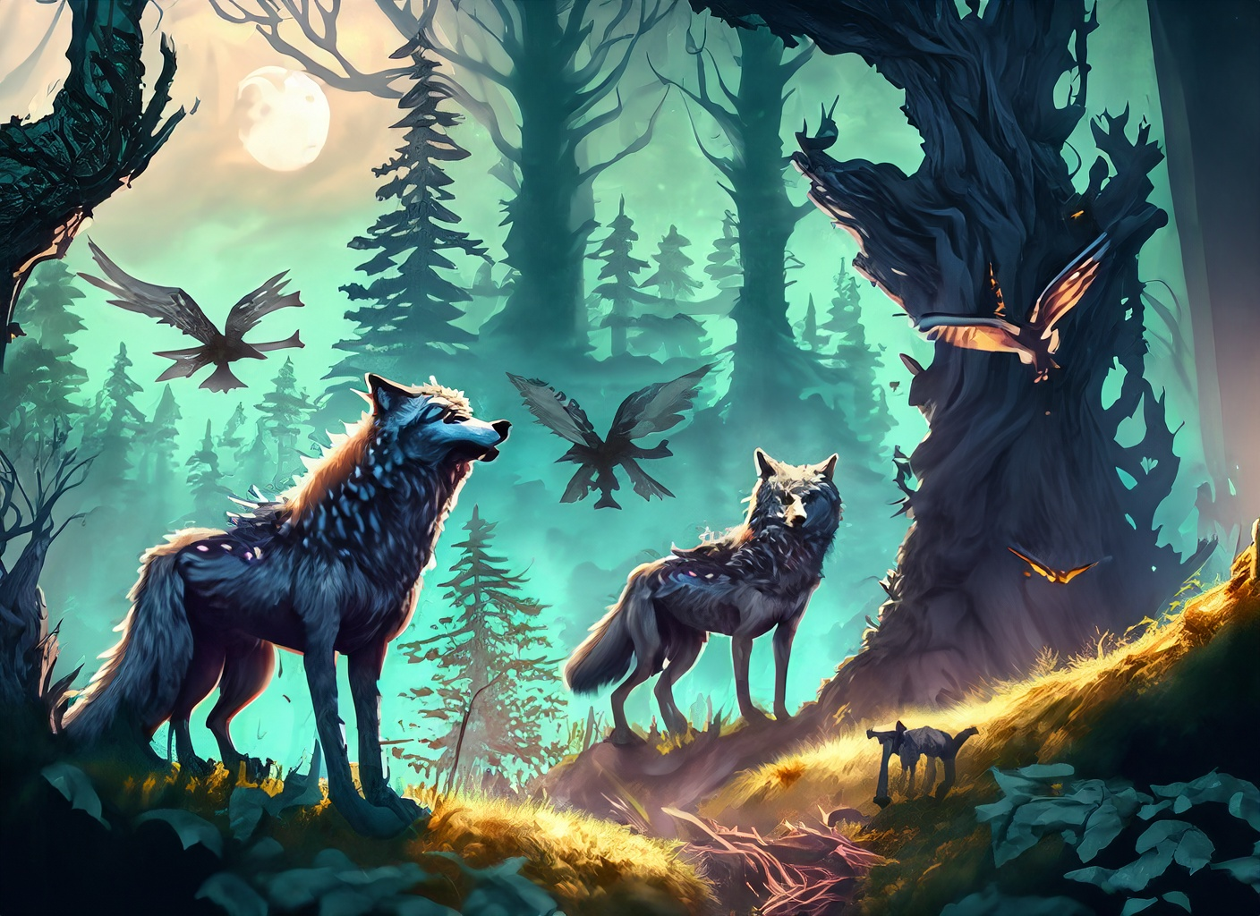
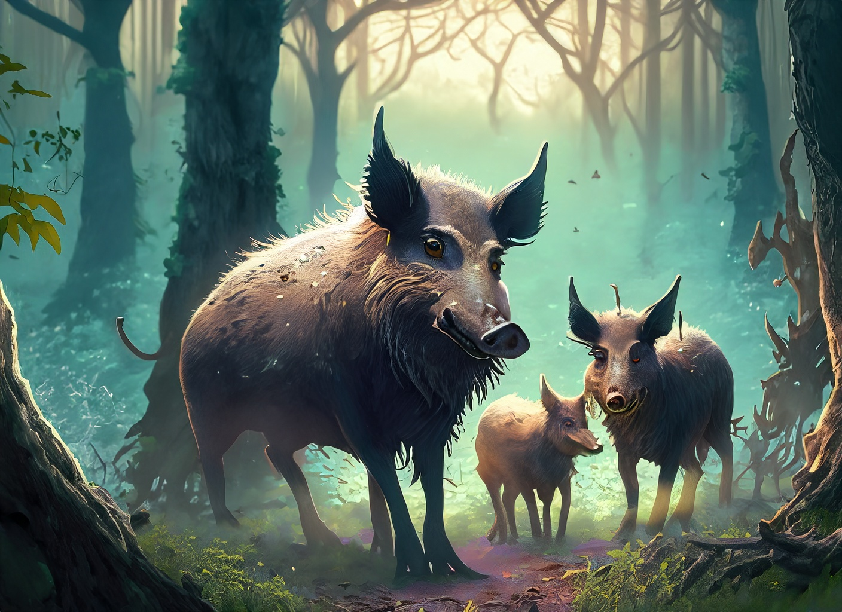
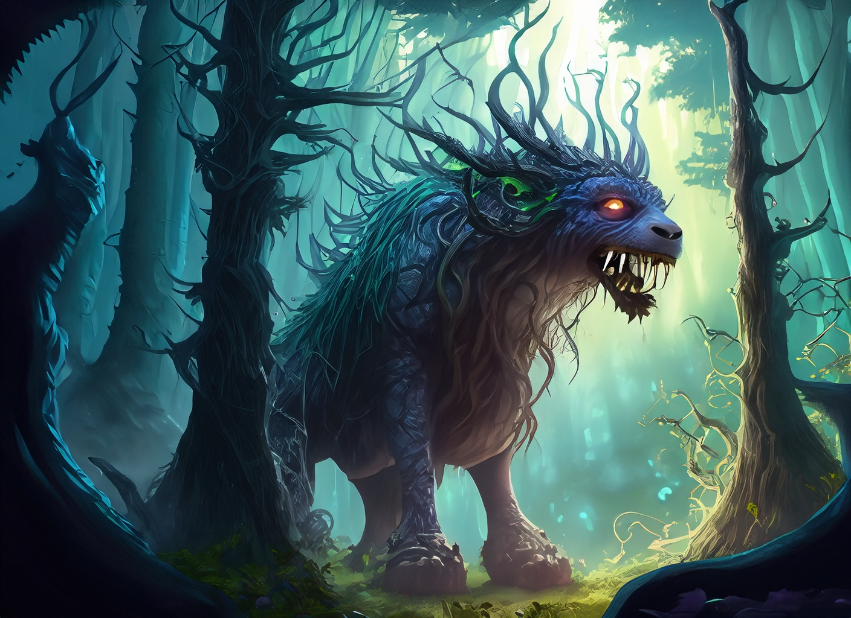
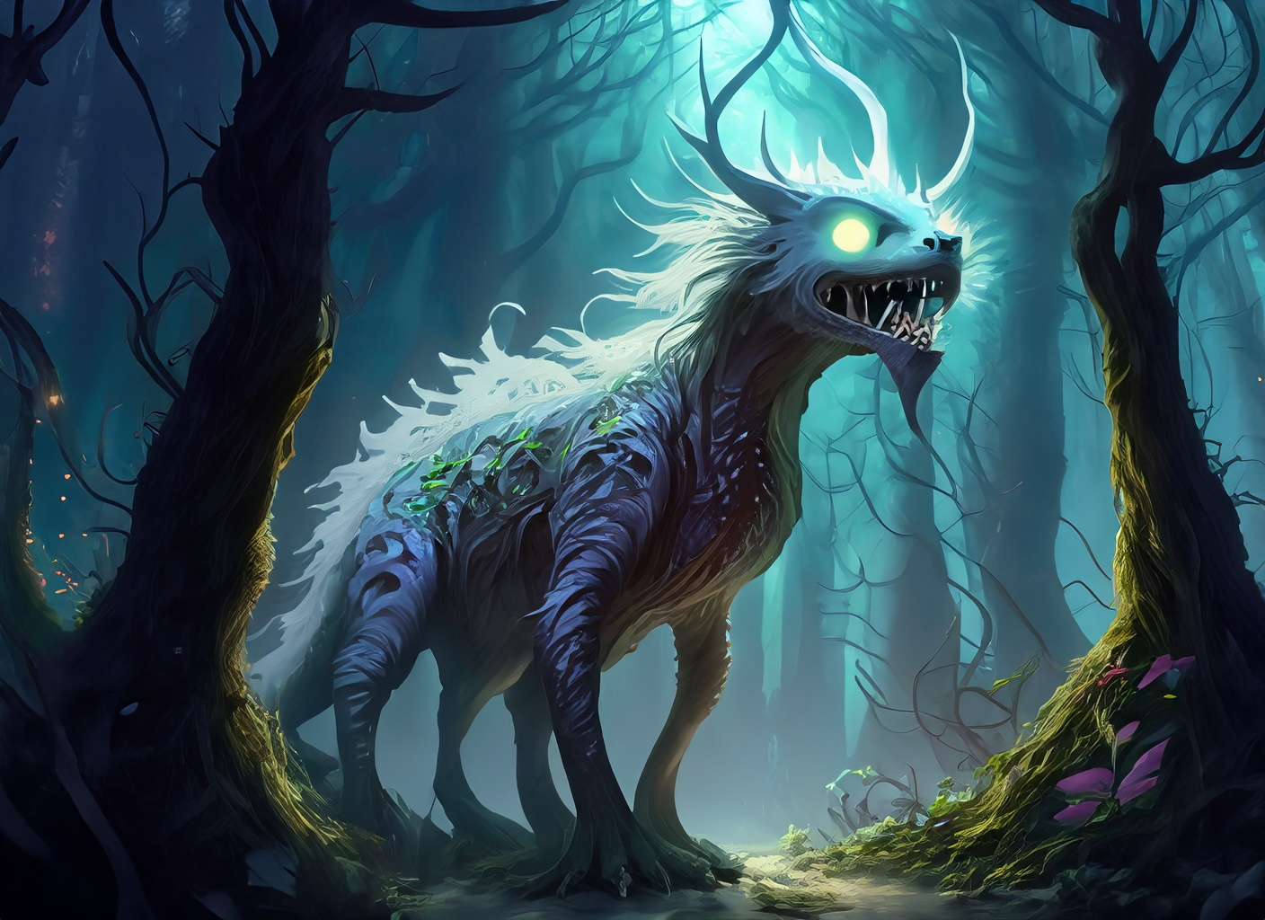
Art: Enemies
Mischievous Insects
Little Monsters
Wolves, Wild Boars and Birds of Prey
The Legendary Monster

Slide 11
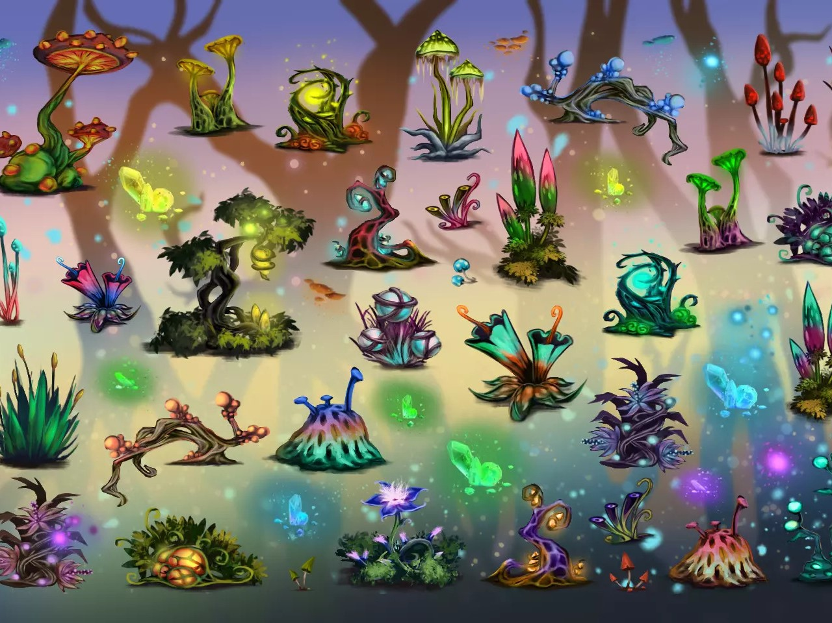
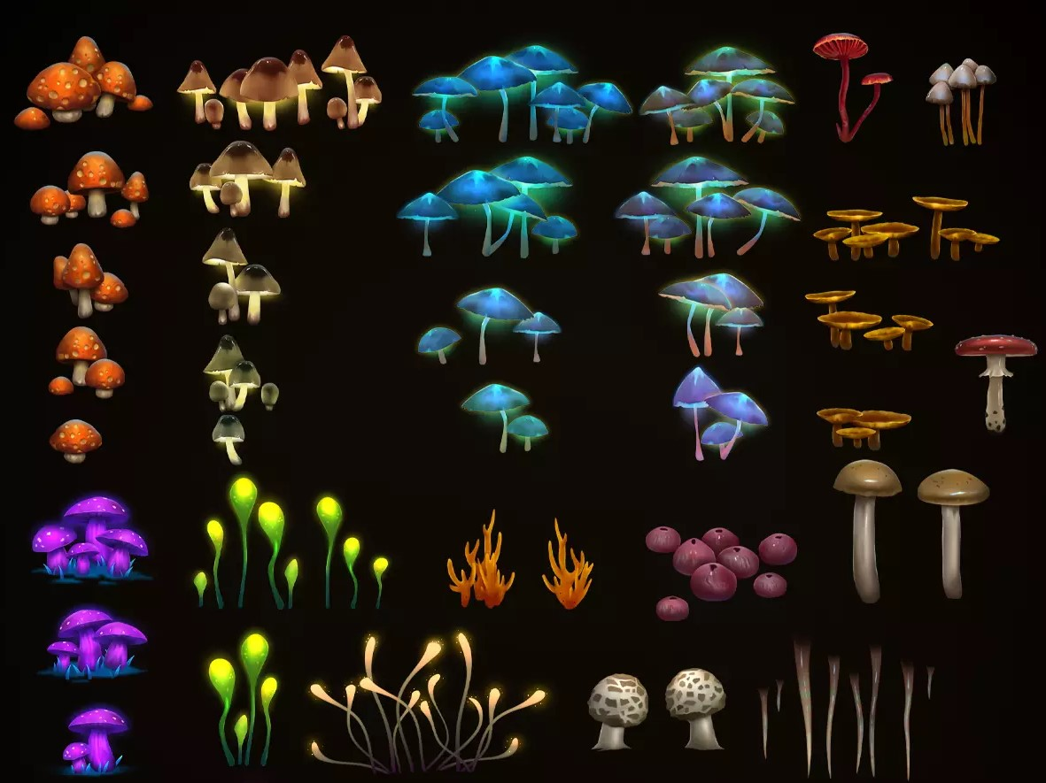
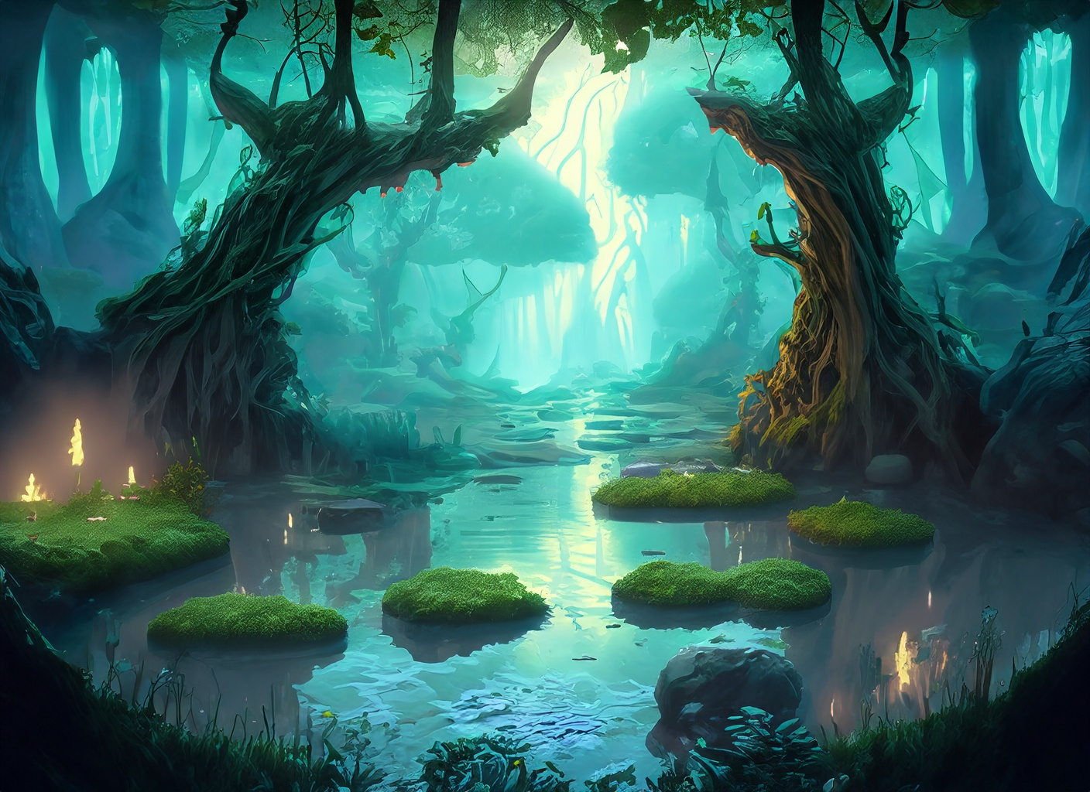
Art: Environmental Obstacles
Challenging Platforms
Hazards
Water and Aquatic Obstacles

Slide 12





Items
Camera Upgrades
Power-Ups
Quiz Boosters
Health Restoratives
Extra Lives

Slide 13
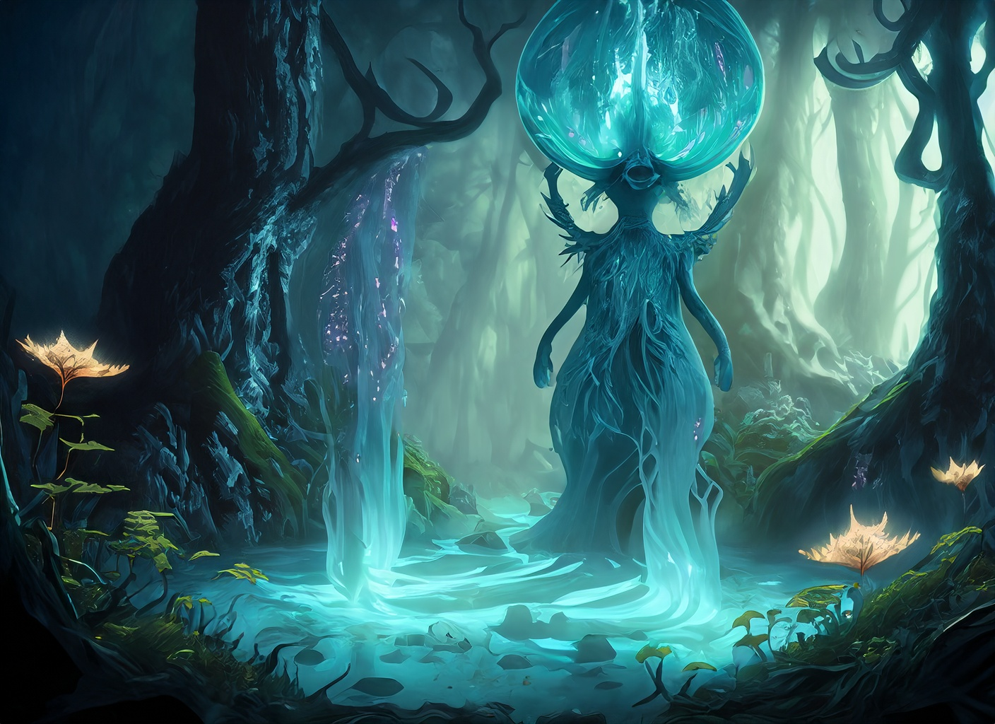
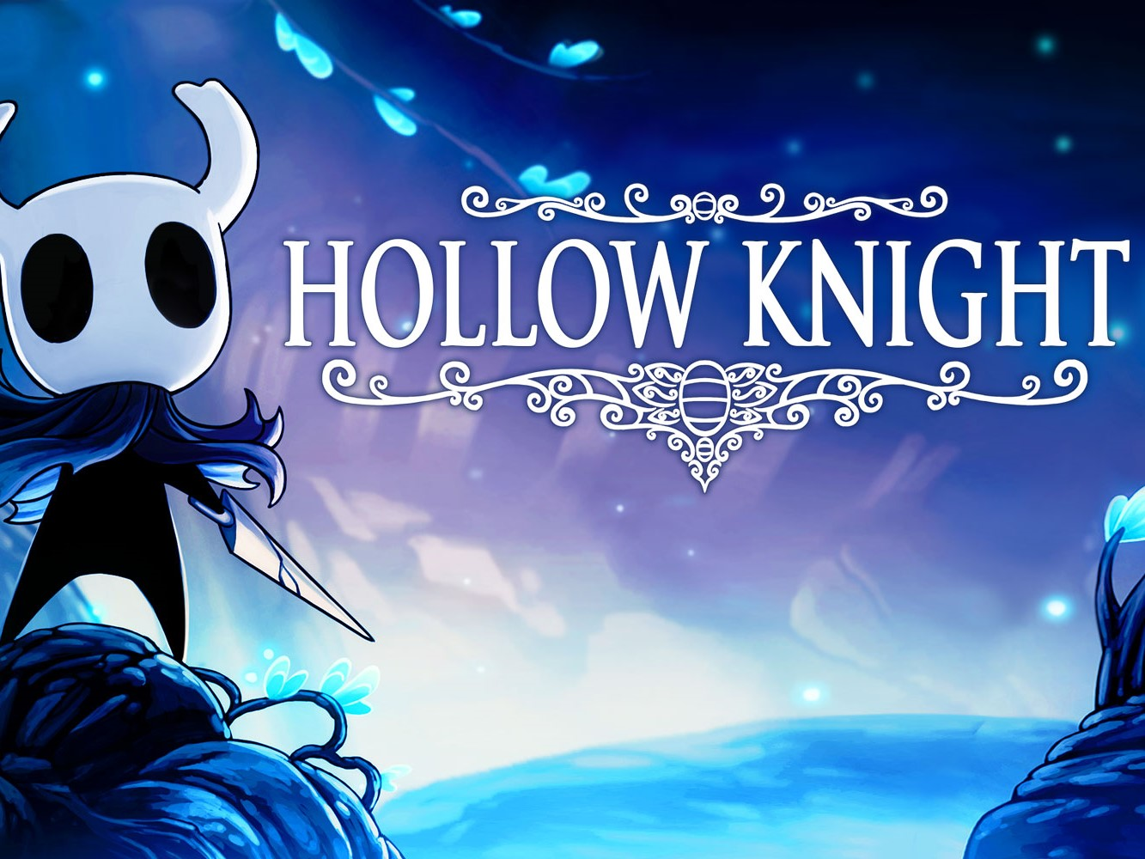
Competitors
Ori and The Blind Forest (3+ mln sales)
2D platformer with stunning visuals, emotional storytelling, and precise platforming mechanics.
Hollow Knight (3+ mln sales)
Atmospheric world, intricate level design, and deep exploration. Its beautiful hand-drawn art style, challenging combat, and immersive gameplay have made it a standout title in the genre
Owlboy (1+ mln sales)
Gorgeous pixel art, compelling storyline, and memorable characters. Its emphasis on exploration,
puzzle-solving, and emotional storytelling resonated with players

Slide 14
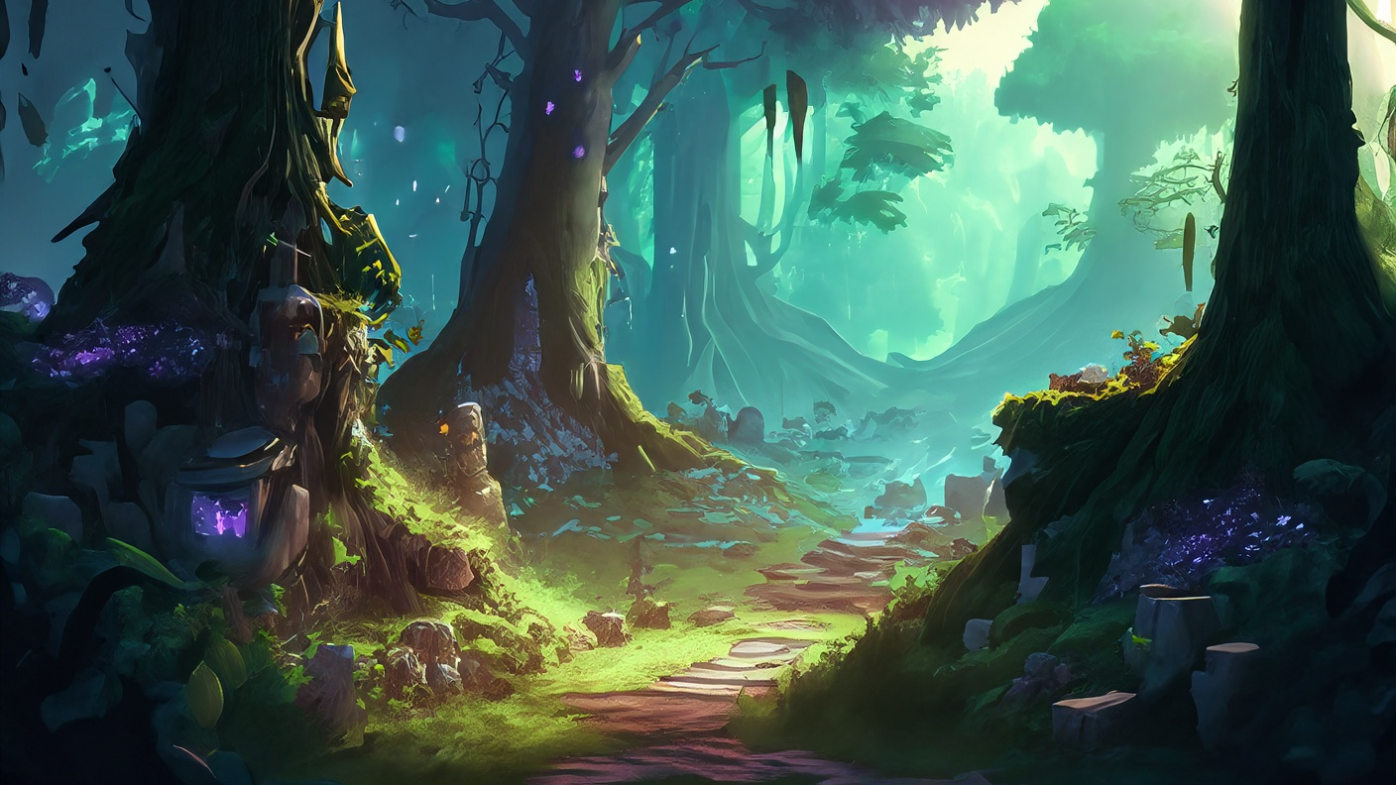
Development Timeline
Idea and Initial Development
Beta
2023
2024
2025
2026
Alpha
Launch and Console Porting

Slide 15
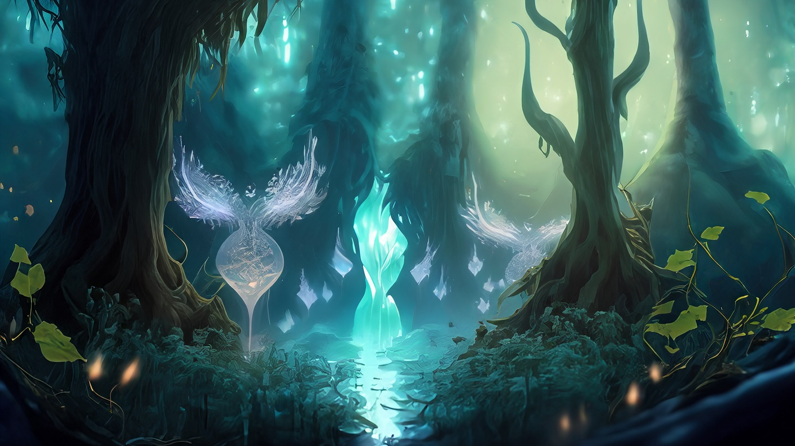
What it is needed
Publisher :
QA Team, Testing, Console Porting,
Localization Team, Marketing Team
Project Finance:
Build up a team work (Programmer, Artist, Audio Artist)

Slide 16





Who am I?
Greta Sorritelli
Passionate about Photography
Bachelor’s Degree in Computer Science
Master’s Degree in Computer Science -
Methodologies and Technologies for Digital Communication
greta.sorritelli@studenti.unicam.it

Slide 17


